Slide 1
INFO1112 Tutorial
Week 11

Slide 2
Assignment 2 – Overview
Due October 22nd
Please look at Edstem before asking any questions
Attempt to read the specs
Requires you to generate a DNS infrastructure:
Change a hostname (alice.bob.carol.dan.eve) into a relevant port (2235), consider everything through this overall idea

Slide 3
Homework stuff
Homework 5 – Interviews

Slide 4
Brief summary of this week’s content

Slide 5


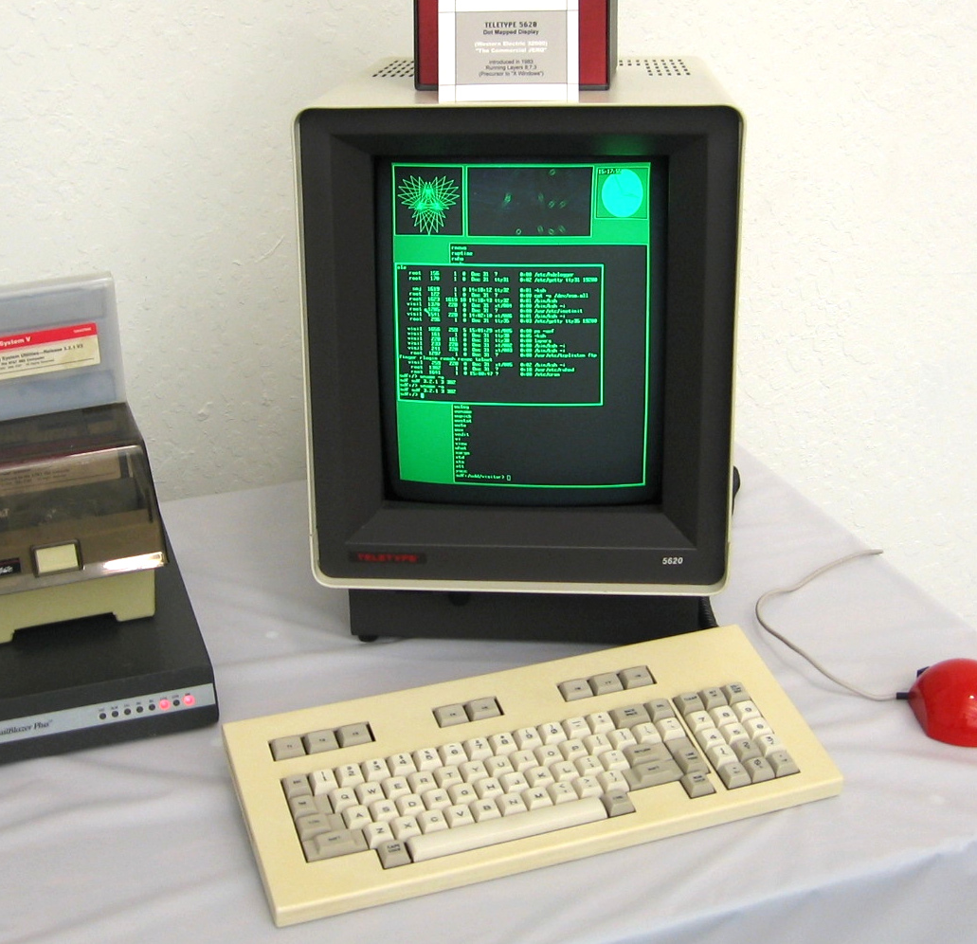
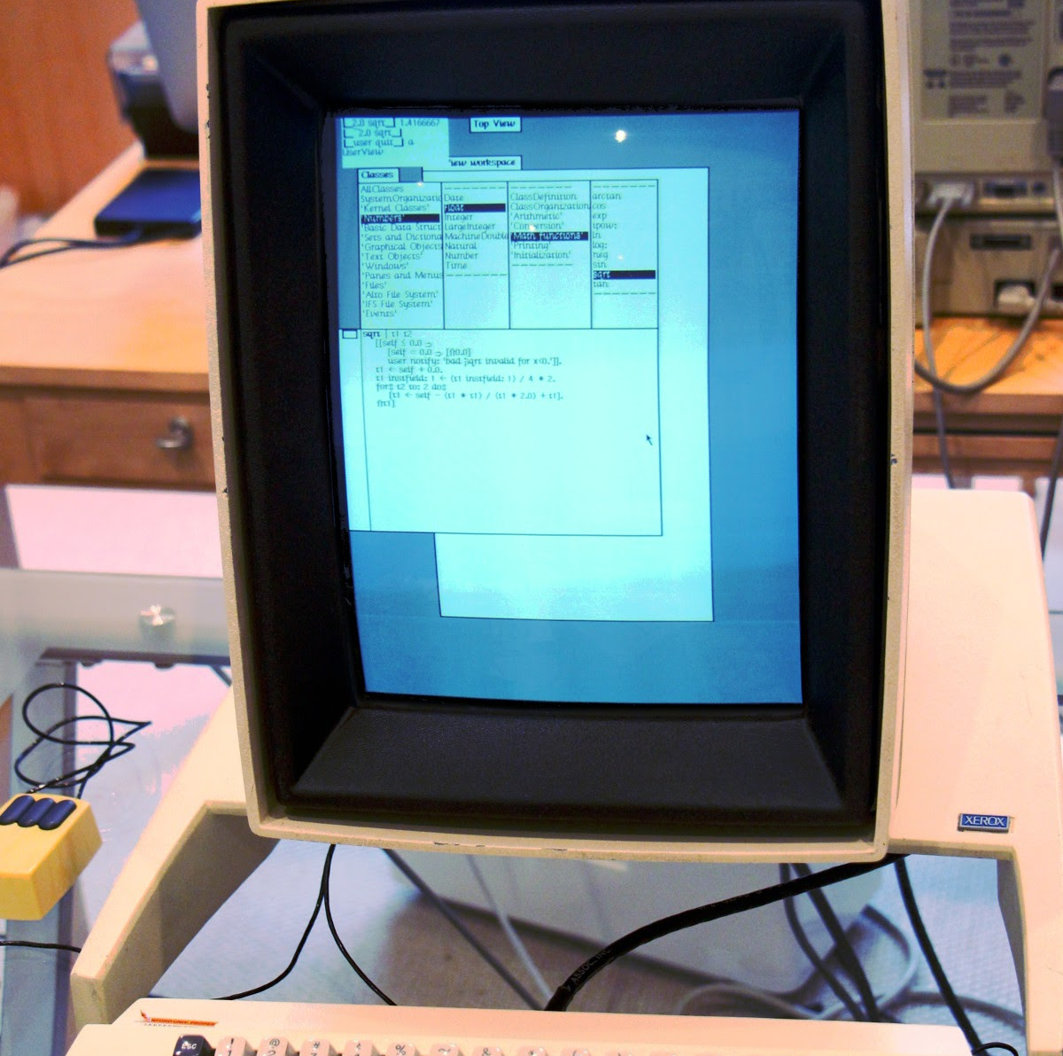

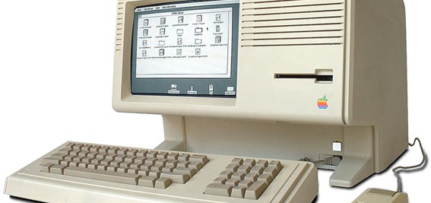
11.1 – Window Systems and Android
History of window-based GUIs
Original Unix system (1969) was a command-line interface (CLI)
Xerox Palo Alto Research Centre (PARC) invented graphical user interface (GUI), with mouse, as research, on the Xerox Alto machine
Apple was inspired by this – in 1981 released the Apple Lisa, first commercial GUI PC
First Unix window system: BLIT (1982)
Special program running in terminal

Slide 6
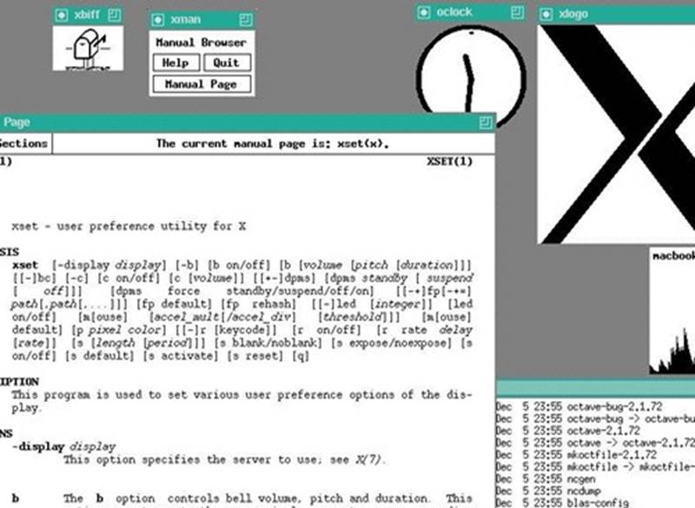
11.1 – Window Systems and Android
History of window-based GUIs
1984 – first mainstream Unix window system, X Window System, developed at MIT
Spun off into open-source X.Org project, still used by most Linux desktop distributions today
1985 – Release of Microsoft Windows 1.0

Slide 7
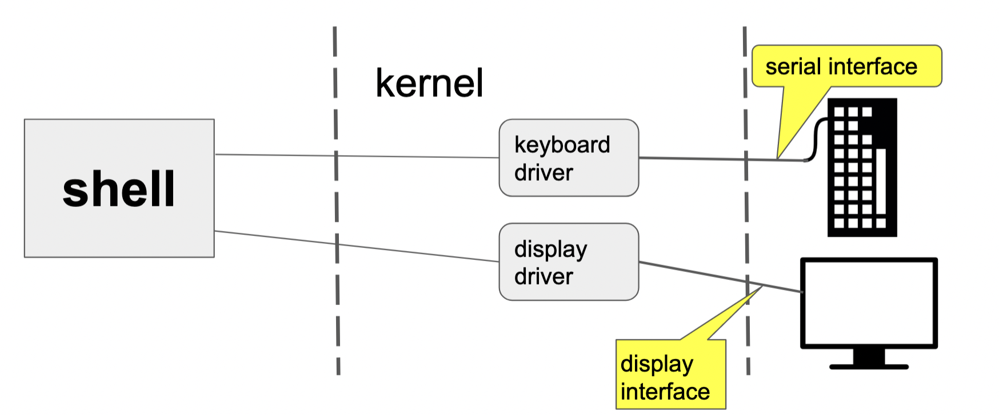
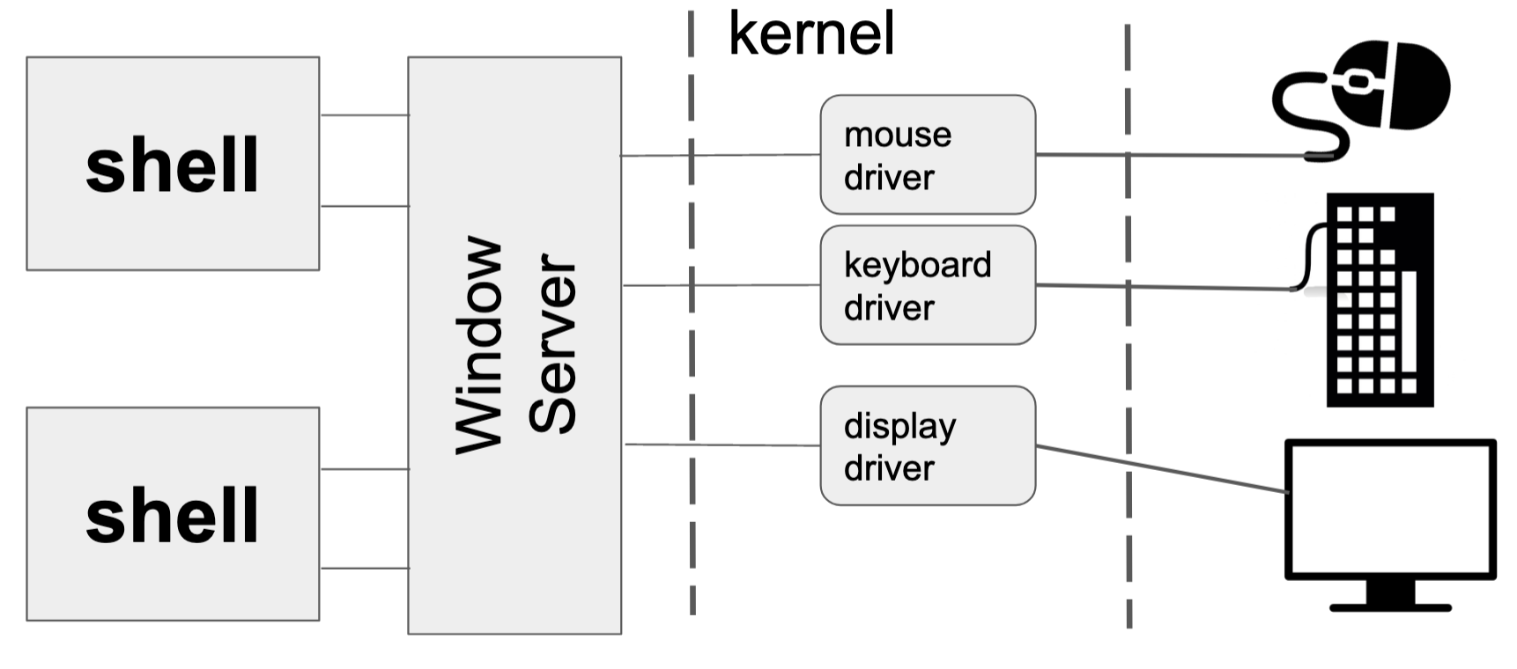
11.1 – Window Systems and Android
Interacting with a computer using a keyboard
Interface directly with shell via keyboard
Interacting with a computer using a keyboard
Window server intercepts interaction with screen elements
Window server then interprets actions, and provides commands for shell to execute

Slide 8
11.1 – Window Systems and Android
What is a window server?
Program which holds information about elements on the screen as data structures
Includes:
windows
window elements (such as scroll bars, close/minimise/maximise buttons)
other parts of a user interface
Window server can be broken down into sub-components or programs
Window manager is responsible specifically for displaying windows on the screen
Desktop environment provides overall look-and-feel of interface
OSs such as Linux provide a variety of desktop environments
Each program in a window acts as a client of the server
Server communicates with client to dictate styling of common elements (e.g. buttons, scroll bars, etc.)

Slide 9
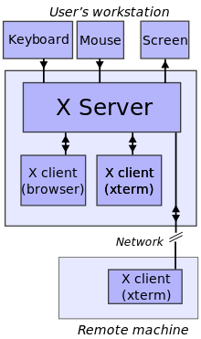
11.1 – Window Systems and Android
Example of window server architecture (X Server)
Note the network component: this allows for a remote client to render windows from a machine running an X Server

Slide 10
11.1 – Window Systems and Android
Android – how does that relate to Unix?
Kernel android uses is based upon Linux kernel (95% similar)
Uses its own window server to display programs as apps
Each manufacturer needs to provide its own drivers so that the phone’s hardware can interact with the common Android software

Slide 11
11.1 – Window Systems and Android
Majority of Android apps are written in Java or a Java-based language
Java is compiled to intermediate common bytecode, which is then executed by a Java Virtual Machine (JVM)
This means that (in general), Java code can be compiled on one machine, and run on a different machine, as long as both machines have a JVM
JVM is open-source, but owned by Oracle
To use the JVM in a commercial project, a license is required
Android initially got around this by writing its own virtual machine compatible with Java bytecode, Dalvik…
…but this got them in a legal scuffle with Oracle!
Dalvik in modern Android
Modern Android apps are compile as native binaries to improve performance
JVM still included in Android for compatibility reasons

Slide 12
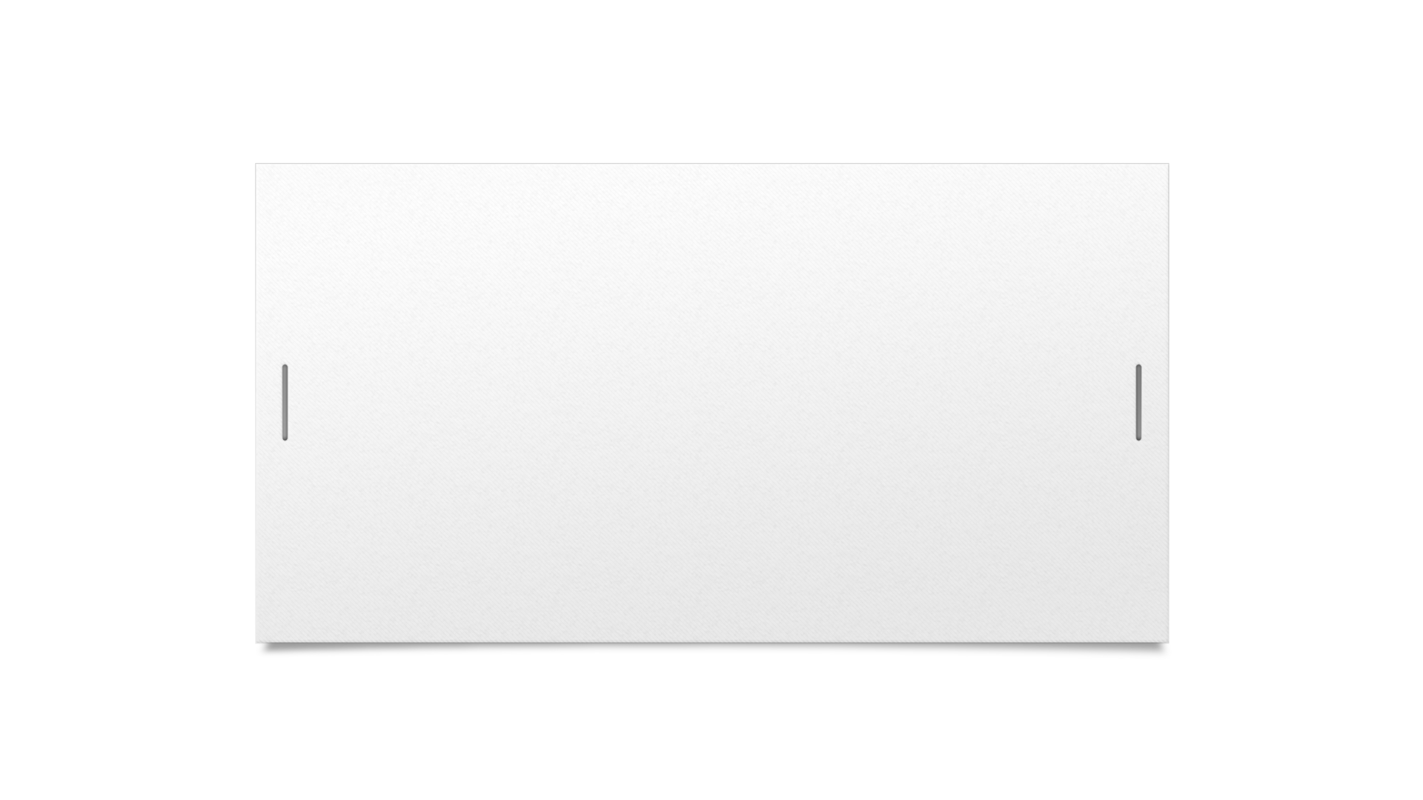
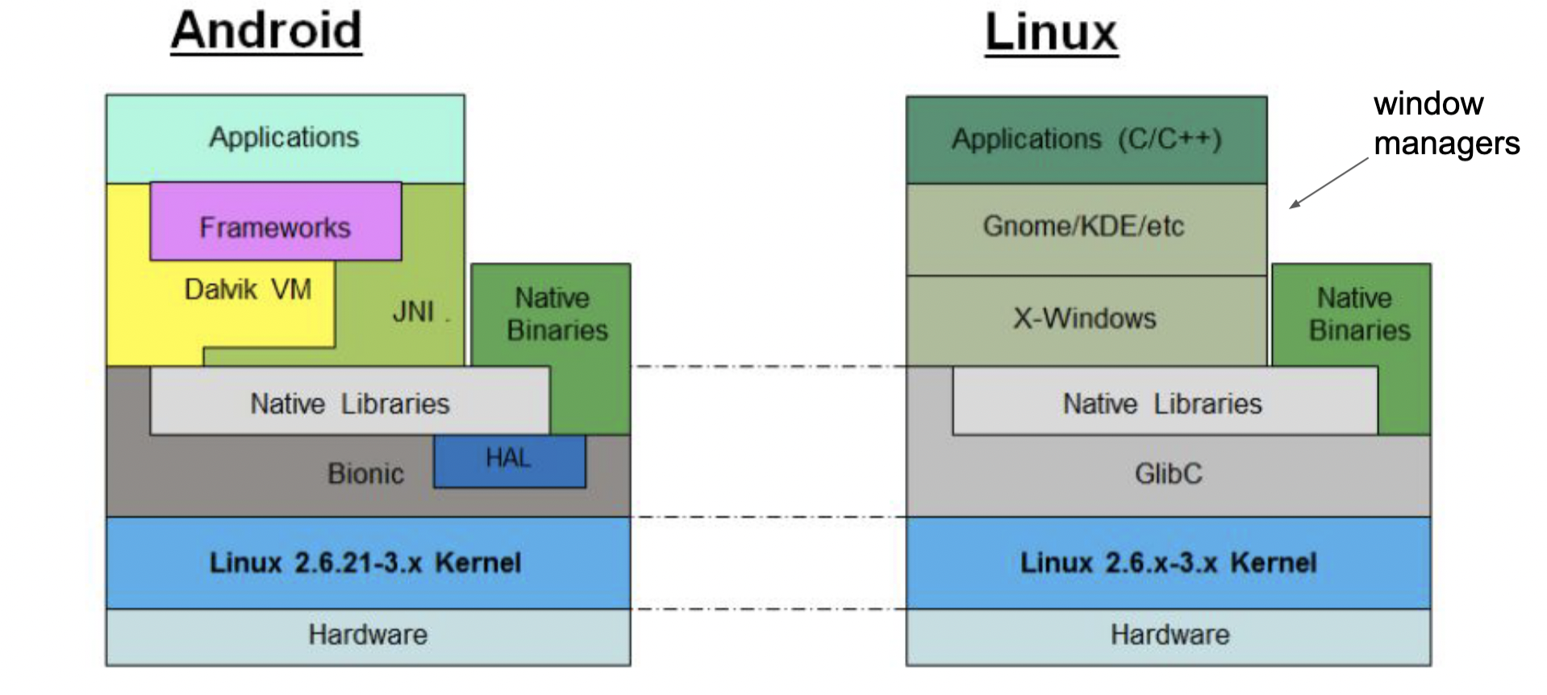

11.1 – Window Systems and Android
Android architecture is similar to that of Linux

Slide 13
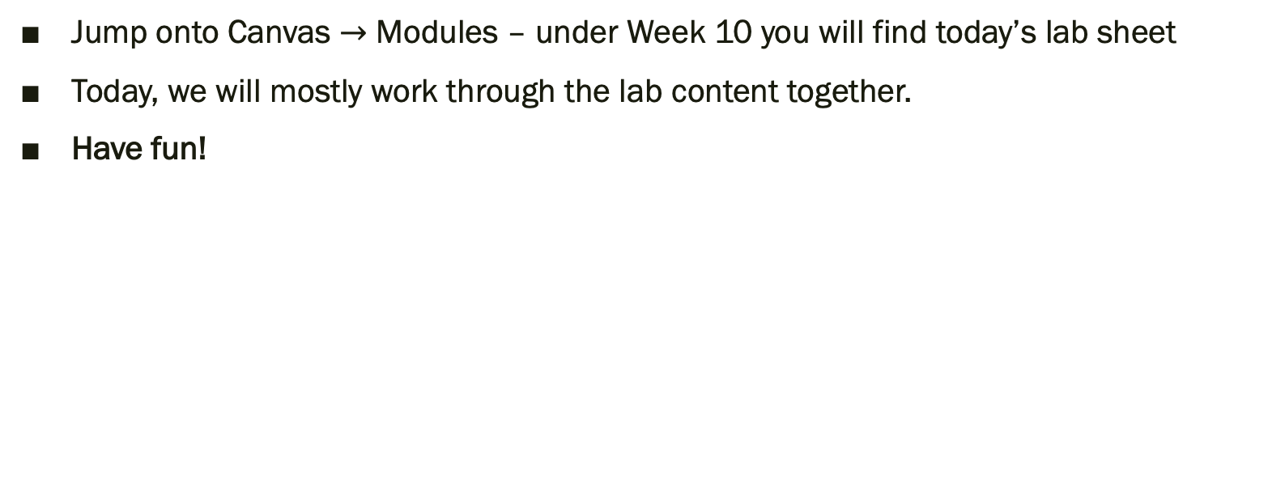
Lab exercises
Jump onto Canvas $→$ Modules – under Week 10 you will find today’s lab sheet
Today, we will mostly work through the lab content together.
Have fun!

Slide 14
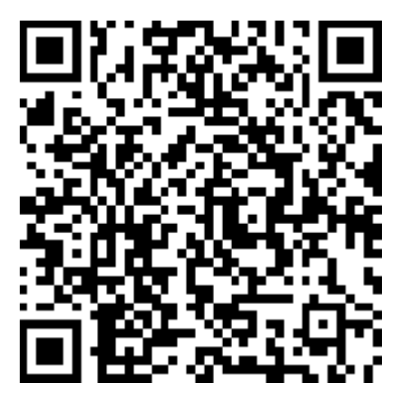
Attendance
https://bit.ly/3OrIYcs

